Slide 1
POWER BI DEPLOYMENT

Slide 2
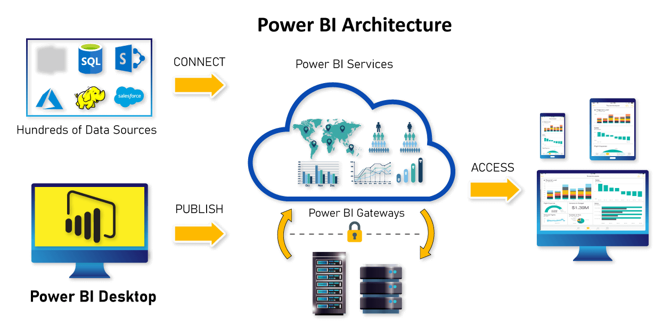
POWER BI DEPLOYMENT Power BI deployment means moving the power bi desktop report to Power BI Services (Power BI Web) so that it can be accessed by web and mobile application through secured credentials.

Slide 3
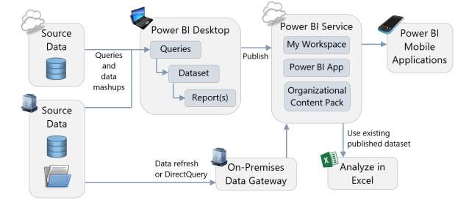
POWER BI REPORT PUBLISHING

Slide 4
WEB VERSIONS SUPPORTS THREE TYPES OF ACCOUNTS
DESKTOP | WEB VERSION
PBIX | URL THE DESKTOP REPORT IS CONVERTED INTO URL WHICH CAN BE SHARED WITH DIFFERENT USERS
Desktop is completely free | Web version have free and pro accounts
Web account can be on Microsoft cloud or it can on the domain of the company
FREE | PRO | PREMIUM
Cloud | On Premises
Data & Report will be stored on Microsoft cloud server and will be managed by Microsoft team | Microsoft Power BI web services will be hosted on in house servers and will be managed by the company

Slide 5
POWER BI SERVICES COMPONENTS / FEATURES
COMPONENTS | REPORTS FEATURES | SECURITY FEATURES
WORKSPACE REPORTS DASHBOARD DATASETS GATEWAY | EDITING POWER BI REPORT EXPORTING POWER BI REPORTS EMBEDDED POWER BI URLS DATA REFRESH SHARING POWER BI REPORTS POWER BI SUBSCRIPTIONS POWER BI ALERTS POWER BI GET DATA | WORKSPACE SECURITY REPORT LEVEL SECURITY ROW LEVEL SECURITY

Slide 6
POWER BI SERVICES COMPONENTS
Workspace
A workspace is a folder which stores the reports.
Report
A Report is PBIX report which is moved from Desktop to Power BI Web Apps.
Dashboard
A Dashboard is a summary page of Power BI Reports which is created from the visualization of Power BI Reports.
Datasets
Gateway
A Dataset is the data associated with the Power BI Reports
A gateway is the bridge between the local sources machine and the dataset in the Report, which should be always on the local machine to refresh the datasets.

Slide 7
POWER BI REPORT FEATURES
FEATURE | DESCRIPTION
EDITING POWER BI REPORT
EXPORTING POWER BI REPORTS
EMBEDDED POWER BI URLS
DATA REFRESH & SCHEDULED REFRESH
SHARING POWER BI REPORTS
POWER BI SUBSCRIPTIONS
POWER BI ALERTS
POWER BI GETDATA

Slide 8
POWER BI SECURITY FEATURES
FEATURE | DESCRIPTION
WORK SPACE SECURITY
REPORT LEVEL SECURITY
ROW LEVEL SECURITY

Slide 9
THANK YOU References

